Slide 1
http://www.mathworks.com/help/images/what-is-image-filtering-in-the-spatial-domain.html The link above contains definitions for both convolution and correlation. Yet I don't see why we treat convolution differently from correlation, and vice versa. It seems to me that convolution and correlation are identical - the only difference being that convolution rotates the filter matrix by 180 degrees. How are convolution and correlation used - also what is the difference between correlation and cross-correlation?
Convolution vs Correlation
Correlation vs Cross-Correlation
Theoretically, convolution are linear operations on the signal or signal modifiers, whereas correlation is a measure of similarity between two signals. As you rightly mentioned, the basic difference between convolution and correlation is that the convolution process rotates the matrix by 180 degrees.
Most of the time the choice of using the convolution and correlation is up to the preference of the users, and it is identical when the kernel is symmetrical.
Also, correlation or auto-correlation is the measure of similarity of signal with itself which has a different time lag between them. Cross-correlation is a way of finding similarity between two different signals.
1

Slide 2
The Basic difference between
Correlation and Convolution is :-
Correlation is measurement of the similarity between two signals/sequences.
Convolution is measurement of effect of one signal on the other signal.
The mathematical calculation of Correlation is same as convolution in time domain, except that the signal is not reversed, before the multiplication process. If the filter is symmetric then the output of both the expression would be same.

Slide 3
Could you please clearly explain what is the difference between correlation and convolution that is done by a filter on an image?
I mean in terms of signal processing definition I know that convolution describes the output of an LTI system, that is if an LTI system produces an output due to convolution with an input system then the output signal can be described as the result of convolution of the input signal and the impulse response of the LTI system. As for the correlation, it describes the similarities between to signals. But how does convolution and correlation effect on a image and how different are they in terms of effects?

Slide 4
Convolution is correlation with the filter rotated 180 degrees. This makes no difference, if the filter is symmetric, like a Gaussian, or a Laplacian. But it makes a whole lot of difference, when the filter is not symmetric, like a derivative.
The reason we need convolution is that it is associative, while correlation, in general, is not. To see why this is true, remember that convolution is multiplication in the frequency domain, which is obviously associative. On the other hand, correlation in the frequency domain is multiplication by the complex conjugate, which is not associative.

Slide 5
The associativity of convolution is what allows you to "pre-convolve" the filters, so that you only need to convolve the image with a single filter. For example, let's say you have an image f, which you need to convolve with g and then with h. f∗g∗h=f∗(g∗h). That means you can convolve g and h first into a single filter, and then convolve f with it. This is useful, if you need to convolve many images with g and h. You can pre-compute k=g∗h, and then reuse k multple times.
So if you are doing template matching, i. e. looking for a single template, correlation is sufficient. But if you need to use multiple filters in succession, and you need to perform this operation on multiple images, it makes sense to convolve the multiple filters into a single filter ahead of time.

Slide 6
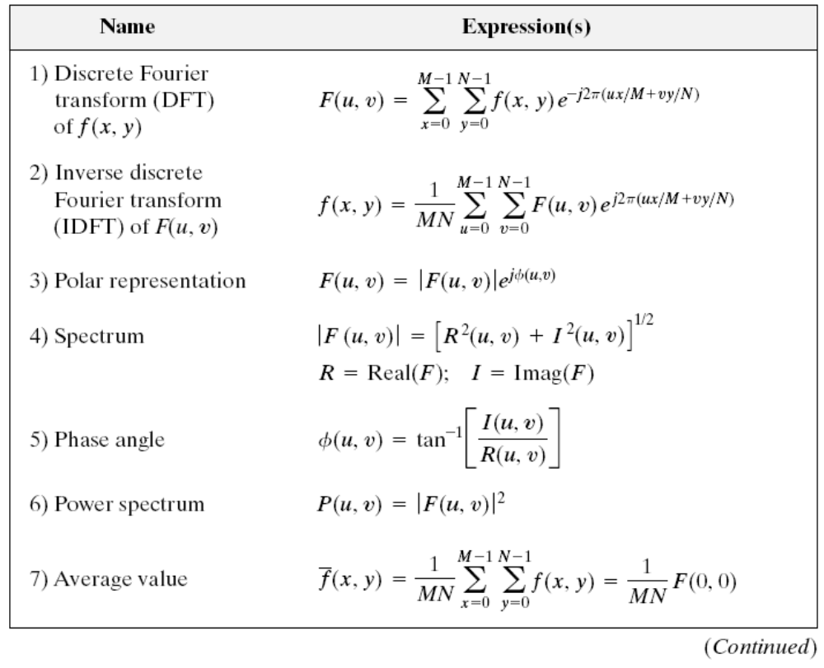
Summary

Slide 7
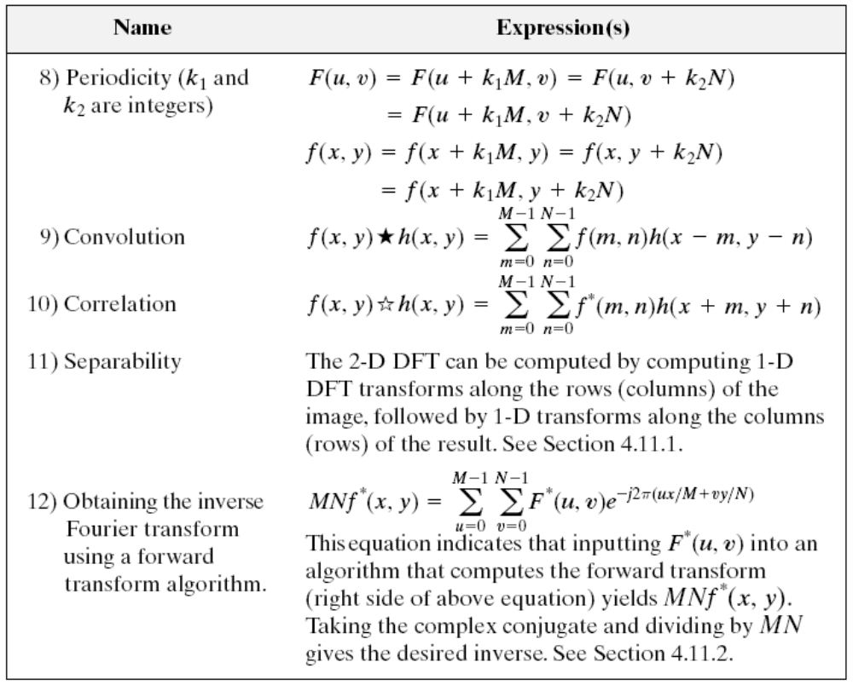
Summary

Slide 8
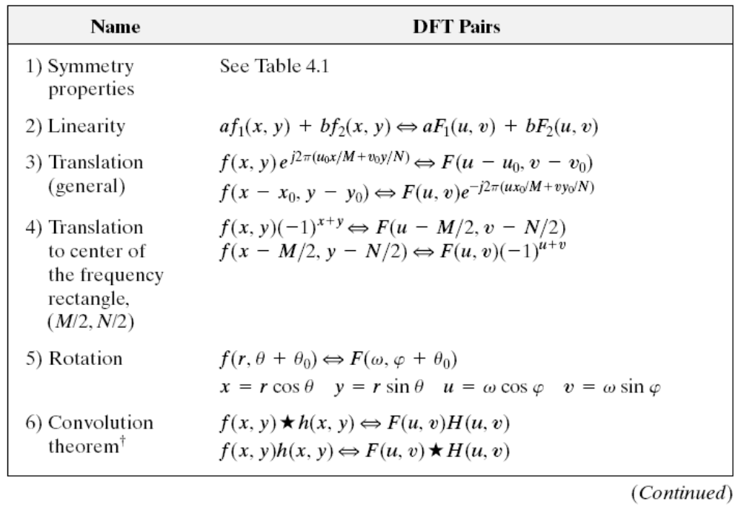

Summary
Dr Pavan Chakraborty, Indian Institute of Information Technology - Allahabad

Slide 9
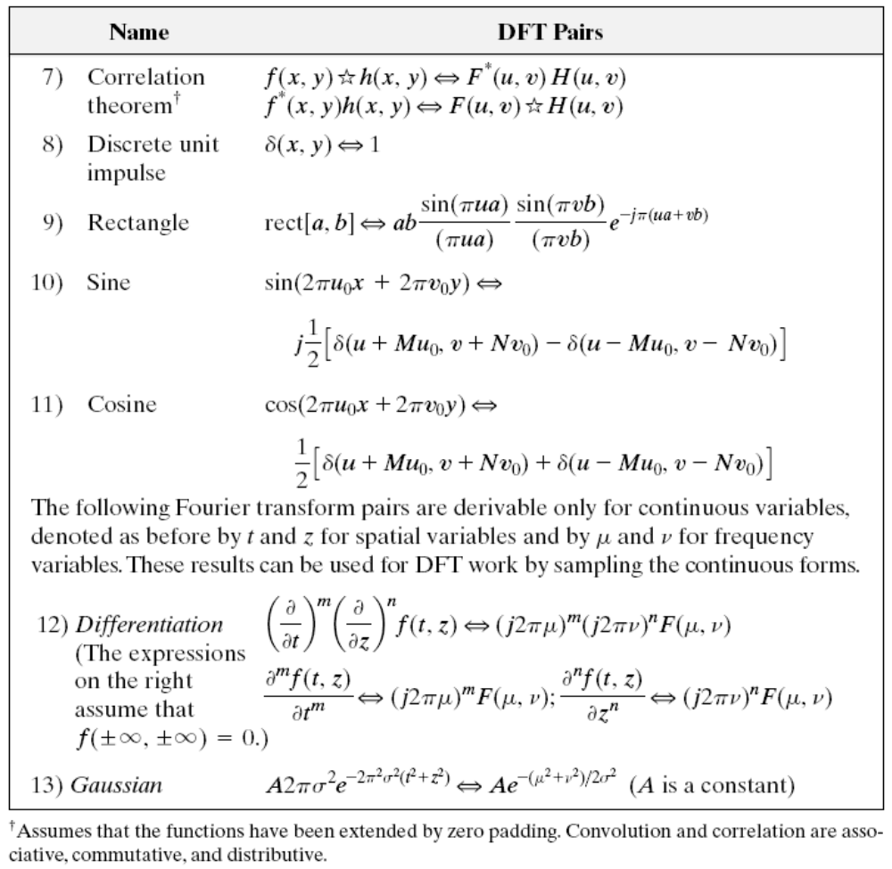

Summary

